Slide 1
Linking HTF haplotypes to O-antigen using local assembly and k-mer analysis
Updates 25th June 2025
jiajun
Next 27th and 28th Aug 4pm…

Slide 2
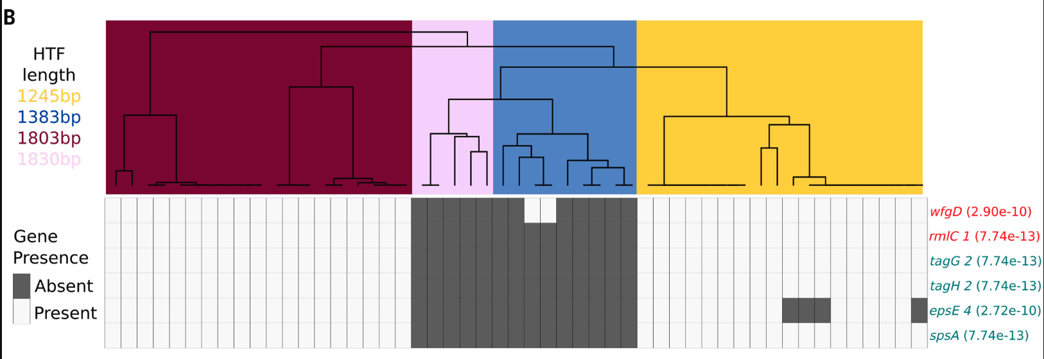
Question:
Is the association between O-antigen and HTF groups in historical samples consistent with the pattern reported in the Science paper?
In science paper

Slide 3
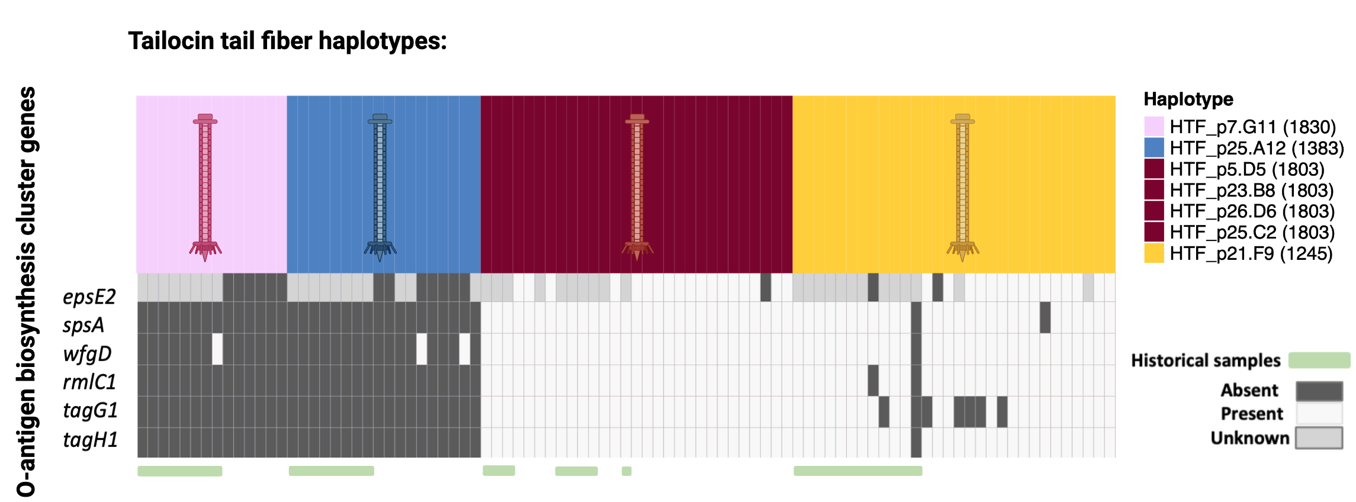




The O-antigen–HTF group association in historical samples matches the pattern from the Science paper, except for two isolates.
Historical samples
Modern samples
Absent
Present
Unknown
55modern + 36 historical
After meeting feedback:
Yellow 10%(2) breaks? Red, no breaks… check if any variance?
Notes:
Mention breaking isolate? Coinfection?

Slide 4
Questions:
1. Are the isolates that break the expected O-antigen–HTF group association pattern authentic?
2. Is there evidence of co-infection among our historical herbarium-derived ATUE5 genomes?
3. How accurate is the HTF haplotype assignment using k-mer and local assembly approaches?
4. Has the HTF group frequency distribution shifted over time?

Slide 5
Questions:
1. Are the isolates that break the expected O-antigen–HTF group association pattern authentic?

Slide 6
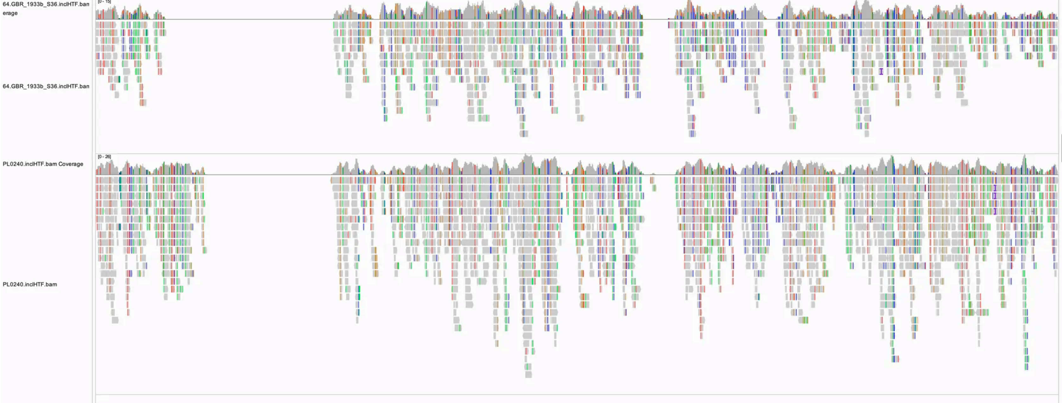
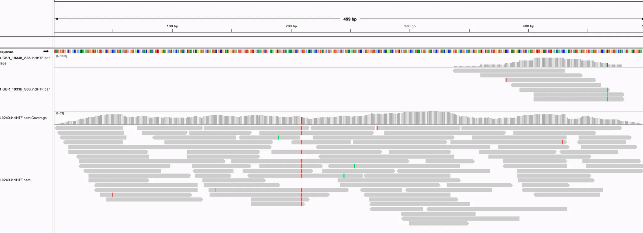
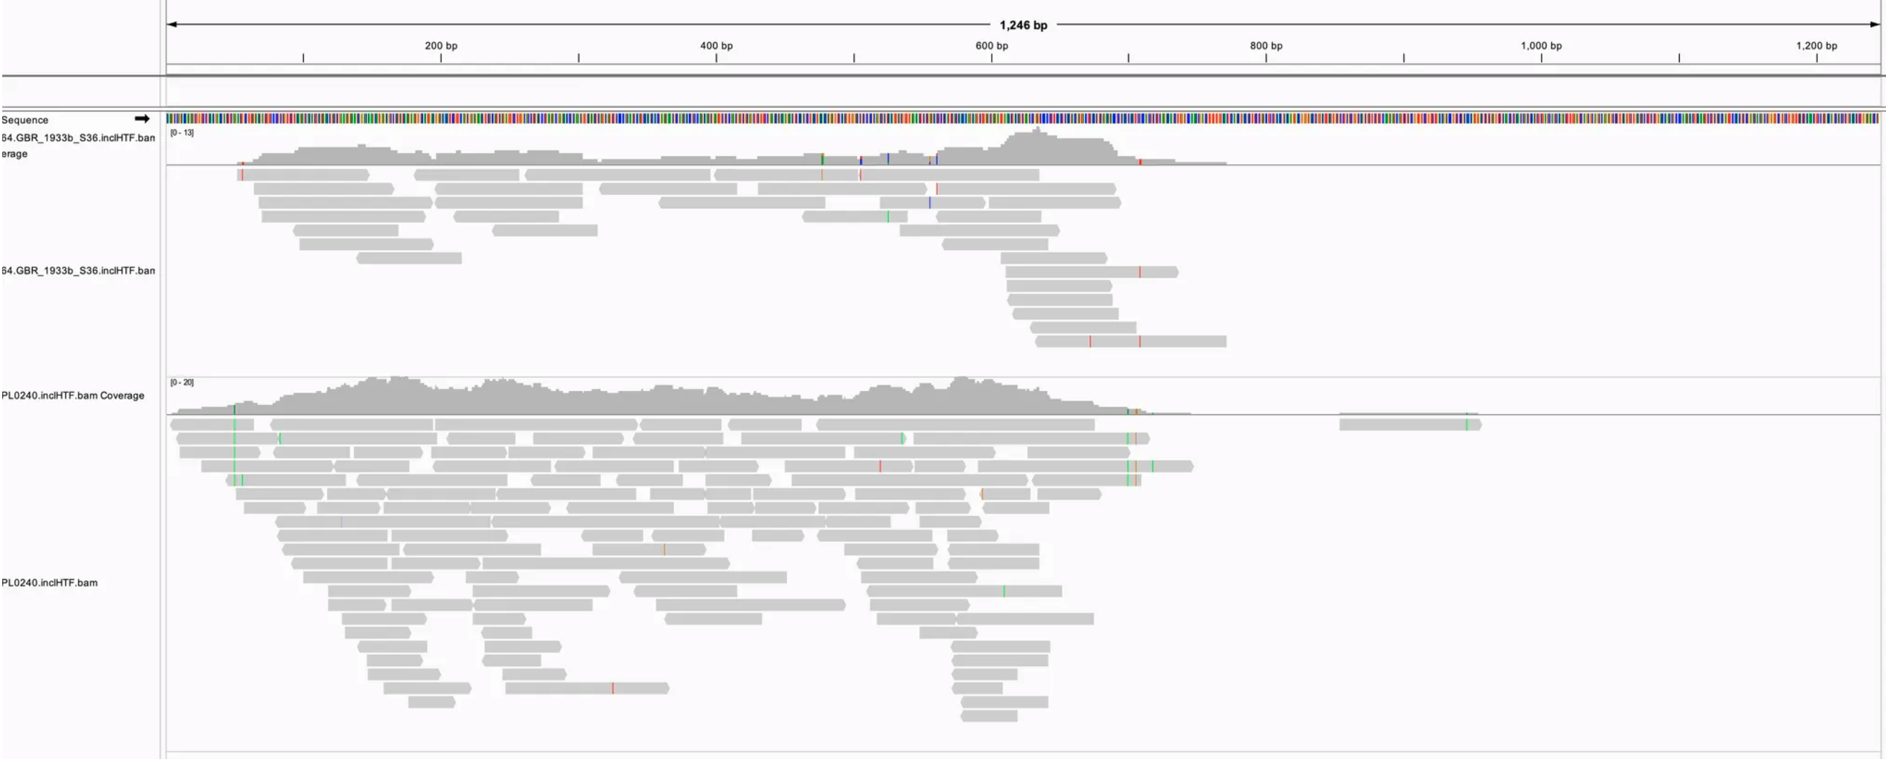
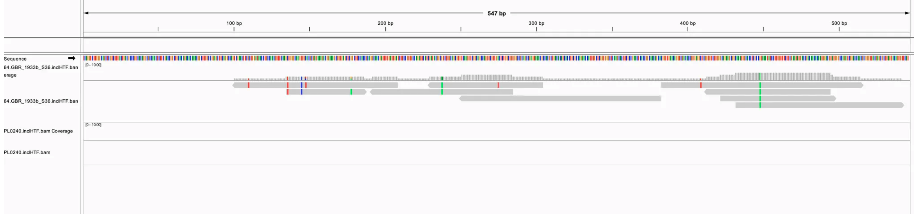
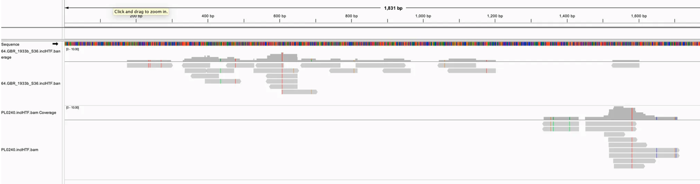
PL0240 is a true exception, while 64.GBR_1933b_S36 correctly links HTF_p7.G11 with O-antigen absence.
Tailocin 1-18057 alignment
PL0240
64.GBR_1933b_S36
HTF kmer distribution
TFA and HTF alignment
TFA_p21.F9 1-498
HTF_p21.F9 1-1245
PL0240
TFA_p21.F9 1-498
HTF_p21.F9 1-1245
64.GBR_1933b_S36
TFA_p7.G11 1-546
HTF_p7.G11 1-1830
After meeting: we are not sure about 64uk, since HTF p7g11 n terminal was mapped by only one chunk
Notes:
add o-antigen, give a confidence matrix of the TFA and HTF

Slide 7
Questions:
2. Is there evidence of co-infection among our historical herbarium-derived ATUE5 genomes?

Slide 8
Three historical isolates show a two-peak k-mer depth pattern, suggesting potential co-infection.
If no co-infection:
Notes:
blob cluster seqs in terms of kmer depth and gc content, gc content like this distribution, supp 3 all the isolate HTF with wg kmer...
If no coinfection first,
Then PL0059… only the background first then overlap….,
Three slides, one for each isolate
Why coinfecton.. PL0240 then this slides

Slide 9
Three historical isolates show a two-peak k-mer depth pattern, suggesting potential co-infection.
Statistic test pipeline to see how diverse /coinfection of one sample from metagenome (like herbarium), to see how to determine which is dominant…
Y axis: htf proportion but not number like 21f9 10000/800 26d6 10000/15
Notes:
blob cluster seqs in terms of kmer depth and gc content, gc content like this distribution, supp 3 all the isolate HTF with wg kmer...
If no coinfection first,
Then PL0059… only the background first then overlap….,
Three slides, one for each isolate
Why coinfecton.. PL0240 then this slides

Slide 10
Three historical isolates show a two-peak k-mer depth pattern, suggesting potential co-infection.
HTF unique kmer count and co-infection potential of three historical samples:
PL0080 Double check p21.F9 and p26d6, the result is f9 but d6 has more power…
Show local alignment as well? See the coverage prop…
In principle the local assembly is more convincing since we use assembly which should have assembled the most frequent sample
Notes:
blob cluster seqs in terms of kmer depth and gc content, gc content like this distribution, supp 3 all the isolate HTF with wg kmer...
If no coinfection first,
Then PL0059… only the background first then overlap….,
Three slides, one for each isolate
Why coinfecton.. PL0240 then this slides

Slide 11
Three historical isolates show a two-peak k-mer depth pattern, suggesting potential co-infection.
HTF unique kmer count and co-infection potential of three historical samples:
Notes:
blob cluster seqs in terms of kmer depth and gc content, gc content like this distribution, supp 3 all the isolate HTF with wg kmer...
If no coinfection first,
Then PL0059… only the background first then overlap….,
Three slides, one for each isolate
Why coinfecton.. PL0240 then this slides

Slide 12
Questions:
Q1: Are the isolates that break the expected O-antigen–HTF group association pattern authentic?
A1: PL0240 is a true exception, while 64.GBR_1933b_S36 not sure.
Q2: Is there evidence of co-infection among our historical herbarium-derived ATUE5 genomes?
A2: Three historical isolates show a two-peak k-mer depth pattern, suggesting potential co-infection.

Slide 13
Corrected:
Historical samples
Modern samples
Absent
Present
Unknown
Potential coinfection samples
64 not sure… check
55modern + 36 historical
Notes:
Mention breaking isolate? Coinfection?

Slide 14
Questions:
3. How accurate is the HTF haplotype assignment using k-mer and local assembly approaches?

Slide 15


The HTF assignment from kmer and from local assembly matched for 47/47 modern samples.
HTF from Science paper
HTF by local assembly
HTF by kmer
talia-backman-Ps1524_tailocin-520ad97/data/supplemental_data/HTF_aa_haplotypes.csv
Notes:
One row by onw row…
Kmer and local, perfect match, fill up,
Science paper, match except grey ones…
observations:
HTF_p7.G11 is absent in the science supp data.
some of HTF_p25.A12 were assigned to other HTF ref than the 7. p3.F8 and p8.C7 are mismatched between supp and my analysis.
white is absence, no data… the white ones at the bymapping row is the 8 that we dont have assembly
white at the first row means for those samples we dont have data in science supp…

Slide 16
Questions:
4. Has the HTF group frequency distribution shifted over time?

Slide 17




Geography map of the 36 historical samples with HTF groups and year
Show box with 4/ 7 ref group…
Show Germany modern 1355 samples location with HTF? Label the city/region inside each country?
Q1 is if freq is persist or not, and answer is yes for now
Q2 is evolutionary process… answer is not sure, maybe independent process in different time or space
Notes:
Show the data discuss how to visualize…
Plot the map… show the space and the year…
Bootstrap? More power…

Slide 18
Next
Determine the presence/absence of epsE2 in historical isolates.
Finish the HTF - O-antigen association figure using the 55 modern assemblies and the complete set of HTF haplotype sequences.
Perform ancestral state reconstruction for HTF haplotype, O-antigen presence/absence, and their co-evolutionary dynamics.

Slide 19
Thank you

Slide 20
No show

Slide 21
Supp2 kmer analysis (check 1524 talia science paper data to add accuracy of modern 55, or later ask for the missed 8 assembly to do mapping, give the info of kmer analysis stepslike ref kmer number)
Modern55 (accuracy )
Historical: we have 36/40 that pass the 65% WG avg filtering and 8/9 samples matched previous mapping assignment except PL0059 (potential co-infection).

Slide 22
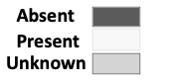

Slide 23

The presence/absence of six O-antigen biosynthesis genes is related to HTF lengths in historical isolates.
Supp1 mapping analysis (now a 24m+9h+7ref tree, want a 47m+9 tree (later 55+9 tree))
Modern samples
Historical samples
Absent
Present
tagH1
spsA
tagG1
rmlC1
epsE2
wfgD

Slide 24
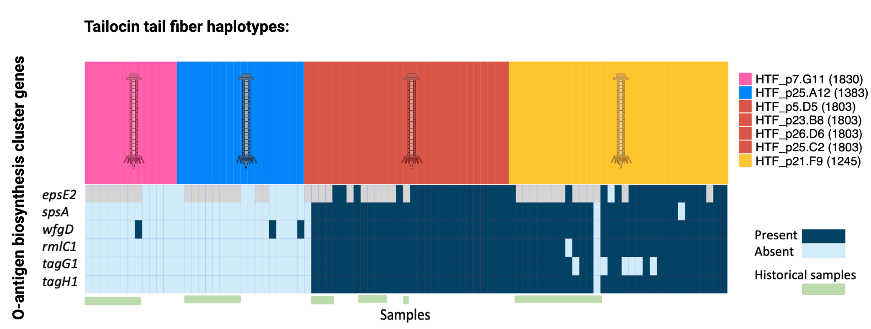
fig1

Slide 25
If 64.GBR is not assigned to HTF_p7.G11

Slide 26
Heterozygosity
Potential coinfection identified by kmer distribution
No coinfection

Slide 28
Concern fixed
figure legend （kmer ref number hammingdistance filtering wg65avg…）
do random select each ref 15kmers？No need
its neutral, you just need at least 1 unique kmer to assign but the more the better..
saved 31 kmers to HTF_p23.B8_unique_filtered_iterative2.txt
saved 15 kmers to HTF_p26.D6_unique_filtered_iterative2.txt
saved 746 kmers to HTF_p21.F9_unique_filtered_iterative2.txt
saved 777 kmers to HTF_p25.A12_unique_filtered_iterative2.txt
saved 993 kmers to HTF_p5.D5_unique_filtered_iterative2.txt
saved 1063 kmers to HTF_p7.G11_unique_filtered_iterative2.txt
saved 1167 kmers to HTF_p25.C2_unique_filtered_iterative2.txt

Slide 29
Next before the tailocin meeting Wednesday
before wed tailocin meeting:
merge the dist of wg kmer and HTF kmer done
figure legend (kmer ref number hammingdistance filtering wg65avg…)
send the email today: ask and include others than 7 haplotype… also ask the 8 missing asseblies..
add one figure: x is HTF haplotype, y is exact time… show the frequency of different HTF groups through time (not only historical and modern) done
next week:
asr
saron’s method, correlate P/A of oantigen with the presence of HTF haplotypes by phylogeny method… then
asr of HTFs Q: how often they switch… how long presence.. frequency… both oantigen p/a and HTF haplotypes. and inspired by saron, have a combination of this x and y… to query the state (HTF, o-antigen)
2. assemble whole genome PL0240…
3. poster draft… TMP

